Slide 1
Setting up and running Postal Code Conversion File Plus (PCCF+)
Health Analysis Division
Statistics Canada
Prepared 3 July, 2019

Slide 2
Step 1: Creating input file
Input file needs to consist of only two variables:
ID – unique identifier (15 character string)
PCODE – postal code (6 character string)
Create an input file by taking these variables from an existing SAS dataset or by importing other data (e.g. from Excel)

Slide 3
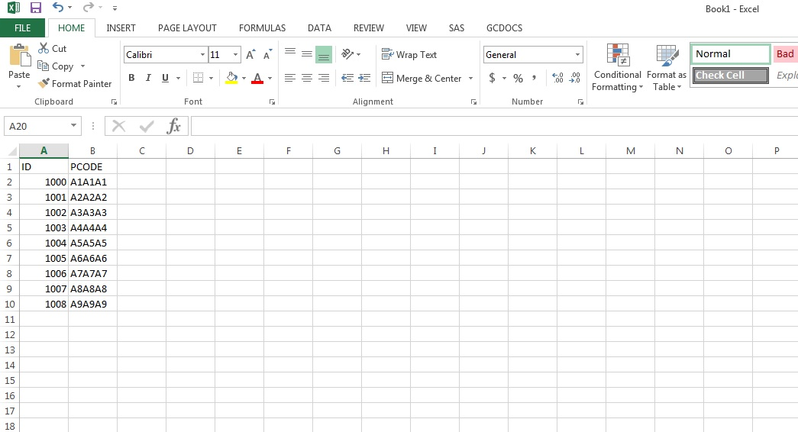
1.1 Produce new dataset: e.g., in Microsoft Excel
Input data must be unique identifier (ID) and postal code (PCODE), and can come from any source.
Tip: if multiple people have the same postal code, format your data with a line for each person.

Slide 4
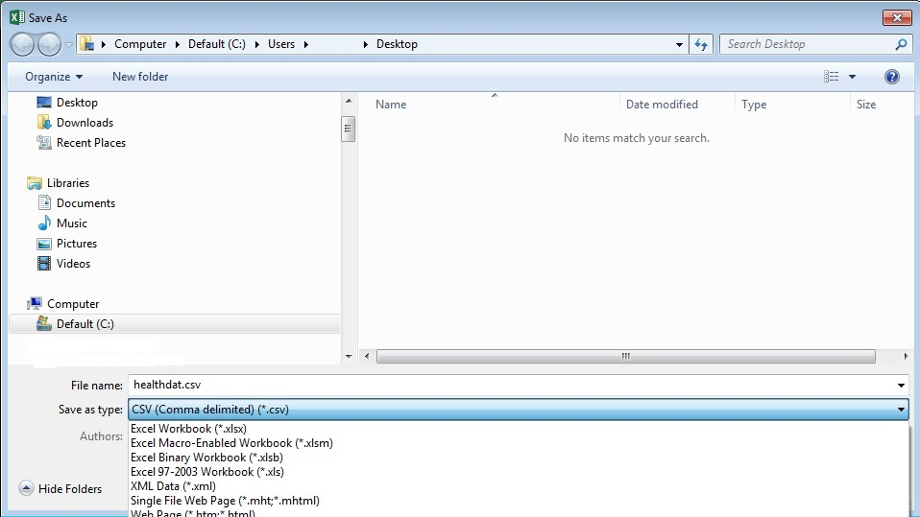
1.2 Save dataset for import: e.g., save as CSV in Microsoft Excel
Save file as CSV ( comma delimited)

Slide 5
1.3 Import input data: e.g., CSV to SAS dataset
Start by opening SAS and creating a new program, by modifying the code below.
Pathway where your csv file is saved, in quotation marks
“work” is the default internal temporary SAS directory
Import CSV of file to SAS

Slide 6
1.4 Transform input data: transform numeric ID variable to character variable
Turn ID from a number into a character variable, by doing a 2-step overwrite of the variable ID

Slide 7
1.5 Transform input data: save SAS dataset to location on server/computer
Specify folder location where you save your work, in quotation marks
Save dataset in that folder

Slide 8
Summary of Step 1 SAS Code
proc import out=work.healthdat
datafile="C:\Documents\healthdat.csv"
dbms=csv replace;
getnames=yes;
datarow=2;
run;
data healthdat2 (drop=id);
set healthdat;
idn=id;
run;
data healthdat3 (drop=idn);
set healthdat2;
id=put(idn,$15.);
run;
libname folder "C:\Documents";
data folder.healthdat;
set healthdat3;
run;

Slide 9
1.6 Verify file creation and close SAS
Check your folder that you named in this step:
libname folder "C:\Documents";
For your file, named healthdat or otherwise
If the file was created, close SAS

Slide 10
Step 2: Running PCCF+
PCCF+ requires six edits to read in the input file and run the program
User needs to make all the edits in the dialogue box, then when finished, set it running

Slide 11
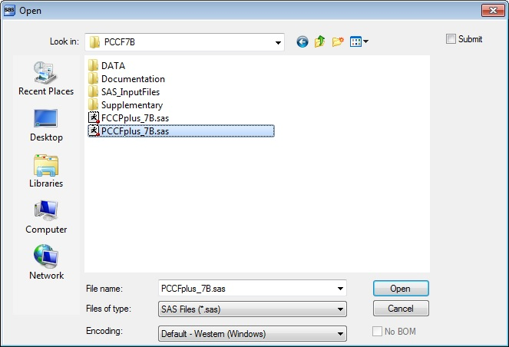
2.1 Open SAS and open the PCCF+ program, as below

Slide 12
2.2 Edit PCCF+ program in SAS: Edit 1
Edit 1: Specify folder location where you have the PCCF+ program and all its datasets saved
Do not use quotation marks or parentheses – see example
Note: do not move the PCCF+ datasets around within the folders

Slide 13
2.3 Edit PCCF+ program in SAS: Edits 2 and 3
Edit 2: Specify folder location where you have the input dataset from Step 1 saved
Put full pathway in quotation marks – see example
Edit 3: Specify the name of the input dataset that you created in Step 1

Slide 14
2.4 Edit PCCF+ program in SAS: Edits 3, 4, and 5
Edit 4: Specify folder location where you want to save your output files
Do not use quotation marks or parentheses – see example
Edit 5: Specify name of your output file
Edit 6: Specify folder name and name of your output pdf files
Put full pathway in quotation marks – see example

Slide 15
2.5 Edit PCCF+ program in SAS: OPTIONAL EDITS
Specify 0 if residential, specify 1 if institutional geocoding*
Specify 0 for most datasets, specify 1 if geocoding British Columbia postal codes beginning with V1H or V9G from before 1997
*PCCF+ assumes most geocoding is residential. If your list of postal codes represent institutions such as nursing homes, seniors homes, hospitals, etc., use the institutional routine.

Slide 16
The edits to the PCCF+ are complete –> run the program in SAS by clicking on the running man icon

Slide 17
Step 3: Checking Outputs
Open up the output folder (user specified) and check three outputs
Check output alongside user guide, which specifies what the variables are, and how to interpret them in the context of your work

Slide 18
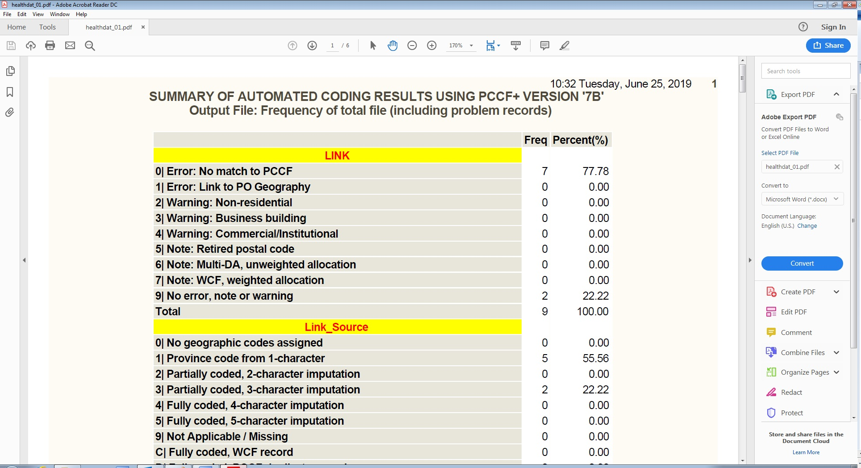
3.1 Check the healthdat_01.pdf which describes the characteristics of the postal codes
N.B. Your file names will be different if you used a different input file name, but the format filename_01.pdf will be consistent

Slide 19
3.2 Check the healthdat_out.csv which will have the full output of PCCF+, including all ID-PCODE combinations
N.B. Your file names will be different if you used a different input file name, but the format filename_out.csv will be consistent

Slide 20
3.3 Check the healthdat_prob.csv which is a subset of file with records that were problematic or may require checks
N.B. Your file names will be different if you used a different input file name, but the format filename_prob.csv will be consistent

Slide 21
For more assistance, contact HAD-DAS@Canada.ca

